Slide 1
雲端計算
Cloud Computing
Overview of Distributed Computing

Slide 2
Agenda
Trends of computing
  Utility Computing
  Cluster computing
  Grid computing
Next big thing
  Cloud Computing

Slide 3
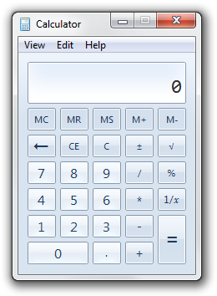

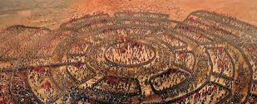
What’s Computing
Calculate
Game theory
Embattle
Your thinking
…

Slide 4

What’s Computing
In computer science
  In a general way, we can define computing to mean any goal-oriented activity requiring, benefiting from, or creating computers.

Slide 5
Computing in Computer Science
Computing includes
  Designing and building hardware and software systems for a wide range of purposes
  Processing, structuring, and managing various kinds of information
  Doing scientific studies using computers
  Making computer systems behave intelligently
  Creating and using communications and entertainment media
  …

Slide 6
…computing may someday be organized as a public utility just as the telephone system is a public utility... The computer utility could become the basis of a new and important industry.
− John McCarthy (a professor of MIT) 1961.

Slide 7
As of now, computer networks are still in their infancy, but as they grow up and become sophisticated, we will probably see the spread of computer utilities which, like present electric and telephone utilities, will service individual homes and offices across the country.
− L. Kleinrock (one of the chief scientists of the original ARPANET project) 1969.

Slide 8

The 5th Utility
Computing will one day be…

Slide 9
The 5th Utility
Traditional utilities
  Water
  Electricity
  Natural gas
  Telephone network
Computing is being transformed to a model consisting of services that are commoditized and delivered in a manner similar to traditional utilities
➔ Utility Computing

Slide 10
Utility Computing
Computing as a Utility
  Provide the basic level of computing service that is considered essential to meet the everyday needs
  Users access services based on their requirements without regard to where the services are hosted or how they are delivered
Offing computing resources as a metered service

Slide 11
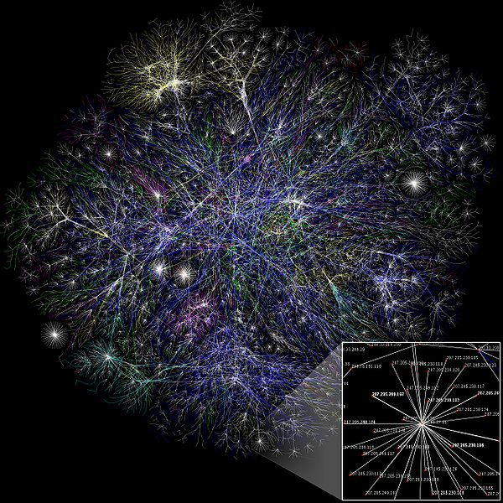
The Creation of The Internet
The Internet is the foremost milestone
Enables individual computers to communicate with any other computers located elsewhere in the world

Slide 12
Variety of Paradigms
New computing paradigms have been proposed and adopted to edge closer toward achieving the vision of computer utilities
Attribute
Accessibility
Manageability
Autonomic
Performance
Scalability
Availability
QoS
SLA
…
Paradigms
Utility Computing
Cluster Computing
Grid Computing
Cloud Computing
…

Slide 13
Distributed Computing
The fundamental notion is…

Slide 14
Distributed Computing
A computer system in which several interconnected computers share the computing tasks assigned to the system
Paradigms
  Cluster computing
  Grid computing
  Cloud computing

Slide 15
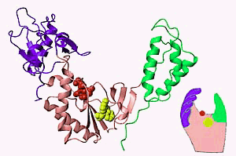

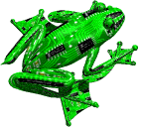
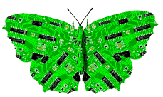
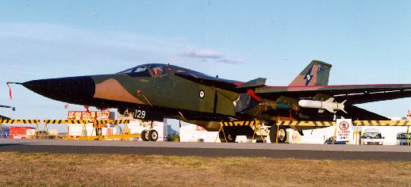
Demand for Computing Power
Solving grand challenge applications using computer modeling, simulation and analysis
Aerospace
Internet &
Ecommerce
Life Sciences
CAD/CAM
Digital Biology
Military Applications

Slide 16
How to Run Applications Faster
There are 3 ways to improve performance:
  Work Harder
  Work Smarter
  Get Help
Computer analogy
  Using faster hardware
  Using optimized algorithms and techniques to solve computational tasks
  Using multiple computers to solve a particular task

Slide 17
History
In the 1980s
  Computer performance was best improved by creating faster and more efficient processors
In the early 1990s
  An increasing trend to move away from expensive and specialized proprietary parallel supercomputers towards networks of workstations

Slide 18
Towards Commodity Computing
Trend of computing
  From specialized traditional supercomputing platforms
  To inexpensive, general purpose systems consisting of loosely coupled components built up from single or multiprocessor PCs or workstations
Low-cost commodity supercomputing
  Linking together two or more computers to jointly solve some computational problem
  Providing high performance computational facilities for large-scale and grand-challenge applications

Slide 19
Traditional Food Chain

Slide 20
Food Chain of Computer
Mini Computer
Workstation
PC
Workstation
PC
Mini Computer
Mainframe
Mainframe

Slide 21
Food Chain of Distributed Computing
Workstation
Workstation
Mainframe
PC
Mainframe
PC
Mini Computer
Mini Computer

Slide 22
Rise & Fall of Computing Technologies
Mainframes
Mini-Computers
Personal Computers
Distributed
Computing
Mini-Computers
Personal
Computers
Network
Computing
1970
1980
1995
2000+

Slide 23
Distributed computing
Cluster Computing
Grid Computing
Cloud Computing

Slide 24
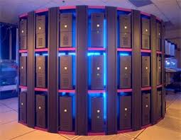
Cluster Computing
A cluster is a type of parallel and distributed system, which consists of a collection of inter-connected stand-alone computers working together as a single integrated computing resource

Slide 25
The Cluster
A Node
  A single or multiprocessor system with memory, I/O facilities, & OS
A Cluster:
  Generally two or more computers (nodes) connected together
  In a single cabinet, or physically separated & connected via a LAN
  Appear as a single system to users and applications
  Provide a cost-effective way to gain features and benefits

Slide 26
Parallel Computing
Parallel Computing
  A form of computation in which many calculations are carried out simultaneously
  Large problems can often be divided into smaller ones, which are then solved concurrently ("in parallel")
Advantages
  Cost efficient
  High performance
  Improve Utilization

Slide 27
Parallel Programming Models
Parallel programming model
  A set of software technologies to express parallel algorithms and match applications with the underlying parallel systems
Flynn’s taxonomy
Shared-memory or Distributed-memory model

Slide 28
Flynn's Taxonomy
Programs and computers are classified by
  whether they were operating using a single set or multiple sets of instructions
  whether or not those instructions were using a single or multiple sets of data
 | Single Instruction | Multiple Instructions
Single Data | SISD | MISD
Multiple Data | SIMD | MIMD

Slide 29
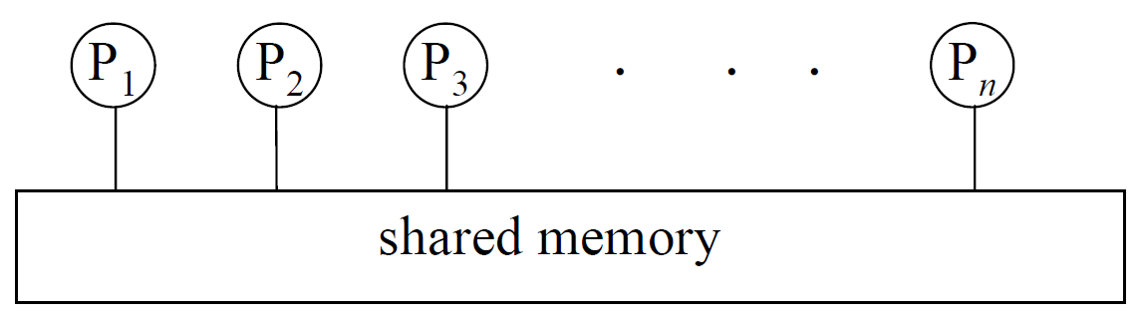
Two Basic Models
Shared memory model
  Memory can be simultaneously accessed by multiple process with an intent to provide communication among them or avoid redundant copies

Slide 30
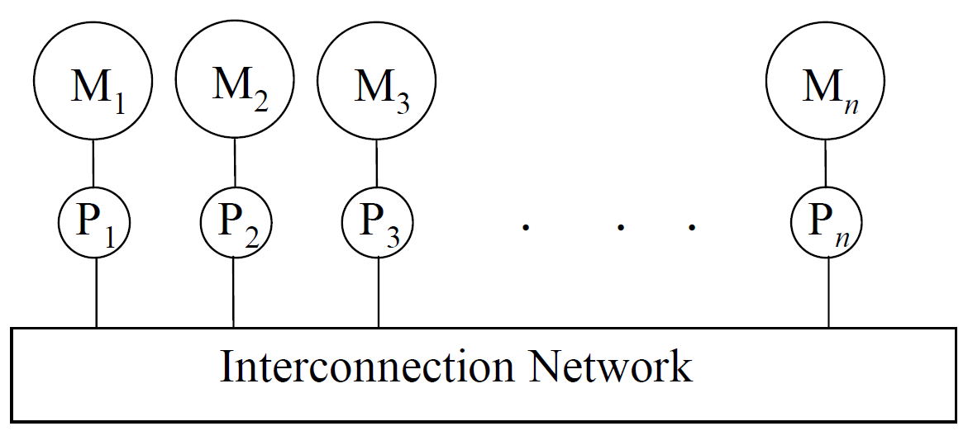
Two Basic Models
Distributed memory model
  A multiple-processor computer system in which each processor has its own private memory
  Computational tasks can only operate on local data, and if remote data is required, the computational task must communicate with one or more remote processors

Slide 31
Computer Collaboration in Cluster
How machines co-work in cluster?
  Using MPI to inter-connect those stand-alone computers
Massage Passing Interface (MPI)
  A specification that allows computers communicate with each other
  Use Message Passing to do synchronization

Slide 32
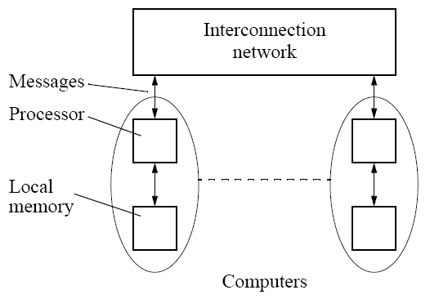
Massage Passing Interface (MPI)
Distributed memory programming model
Complete computers connected through an interconnection network

Slide 33
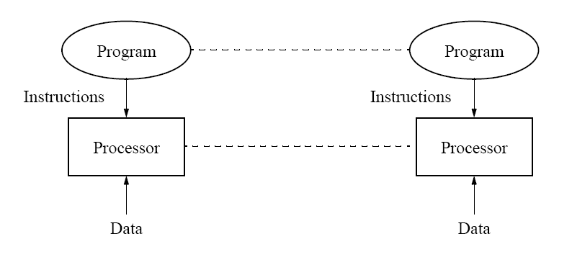
Massage Passing Interface (MPI)
Single program with multiple data (SPMD)
  Similar to SIMD (single instruction multiple data)
the same program

Slide 34
Massage Passing Interface (MPI)
Typical parallel execution flow :
Start
Initialization
Process 1
Process 2
Process 3
▪ ▪ ▪ ▪ ▪ ▪ ▪
Process N
Communication
Communication
Communication
Finalization
Complete

Slide 35
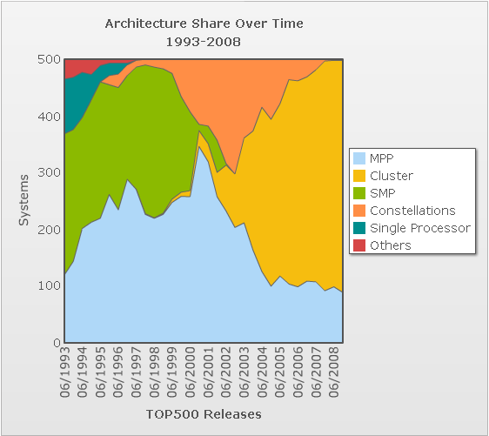
Cluster Applications
Cluster had become the mainstream computing system
Apply parallel program to
  Computing intensive
  Data intensive
  Timing critical system
  … any time you are pleased

Slide 36
Distributed computing
Cluster Computing
Grid Computing
Cloud Computing

Slide 37
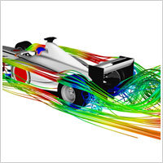
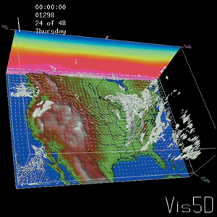
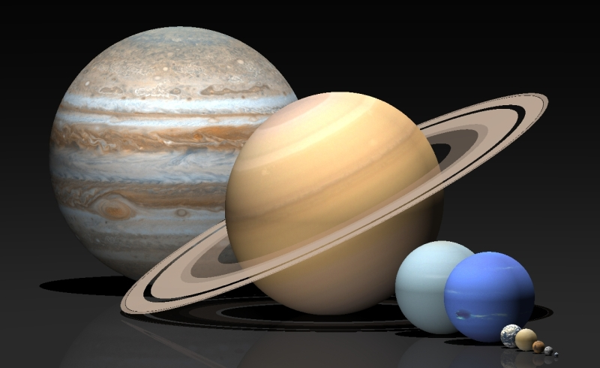
Demand for More Computing Power
The large-scale, computational-/data-intensive scientific applications require more resources
Applications
  Scientific application
  Computer animation
  Computer games
  Image processing
  Data mining
  … etc

Slide 38
Grid Computing
Grid computing
  To coordinate resource sharing and problem solving in dynamic, multi-institutional virtual organization (VO)
Provide the generic approach for a general resource-sharing framework that address the VO requirement
Support the creation and use of computation- and data-enriched environments
Uses open standards and interfaces

Slide 39
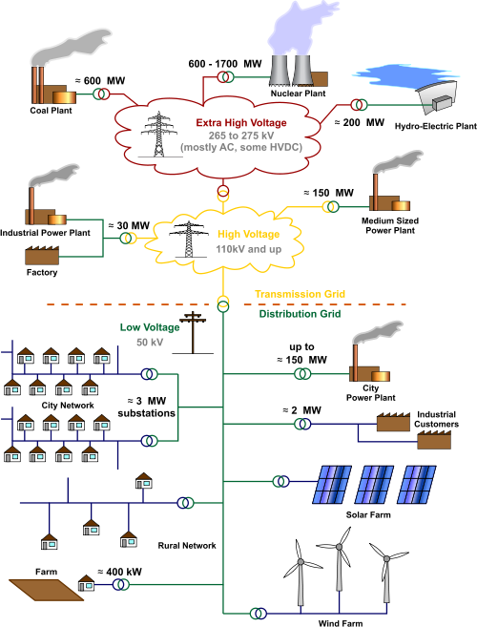
The Grid
Grid
  An analogy with the electric power grid around 1910
  In the mid-1990s, this term is coined to denote a proposed distributed computing infrastructure for advanced science and engineering

Slide 40
Resource Collaboration in Grids
Virtual Organization (VO)
  A set of individuals and/or institutions defined by such sharing rules form
    what is shared
    who is allowed to share
    the conditions under which sharing occurs
An actual organization can participate in one or more VOs by sharing some or all of its resources

Slide 41
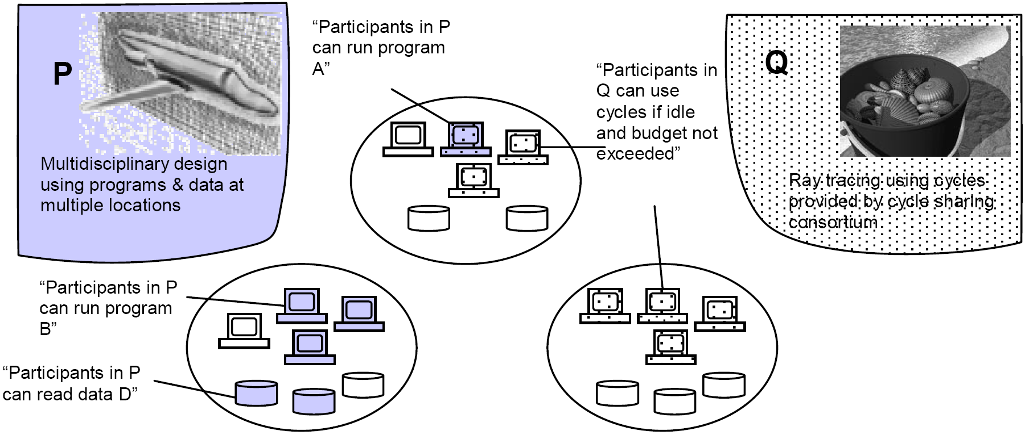
Example of VOs
Three actual organizations (the ovals) & Two VOs (P, Q)
  P: links participants in an aerospace design consortium
  Q: links colleagues who have agreed to share spare computing to run ray tracing computations

Slide 42
Grid Environments
Resources are heterogeneous
  supercomputers, storage systems, data sources, and specialized devices owned by different administrative domains
Enables the sharing, selection, and aggregation of a wide variety of geographically distributed resources
To solve large scale resource-intensive problems in science, engineering, and commerce
Hailed as the next revolution after the Internet and the World Wide Web

Slide 43

Taiwan UniGrid
A University Grid Platform in Taiwan
http://www.unigrid.org.tw/

Slide 44
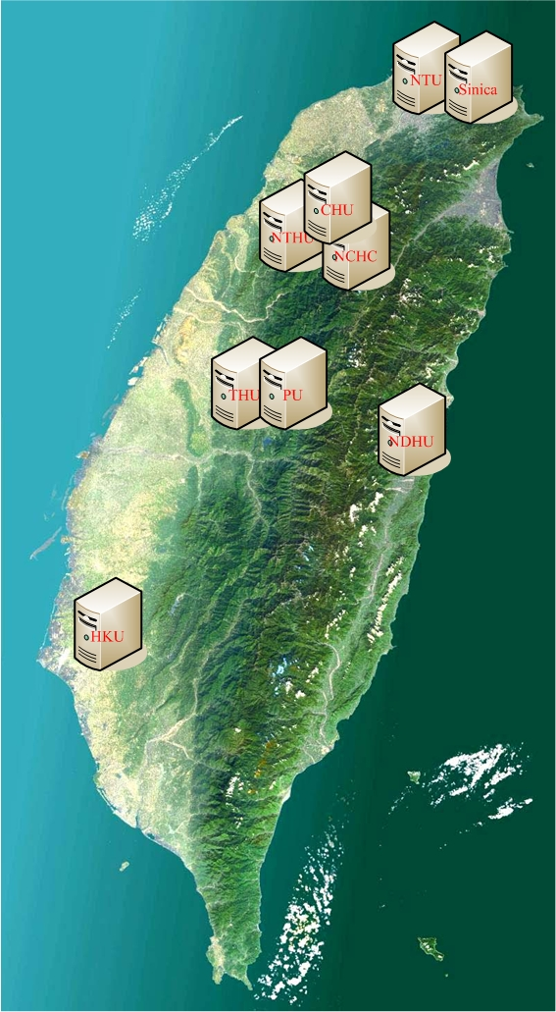
Taiwan UniGrid
Motivation
  Integrate computers from universities and research institutes in Taiwan to form a general purpose Grid platform for researchers in Taiwan to conduct Grid related research
All participating institutes contribute some resources to collaborate for large scale applications

Slide 45
Basic System Architecture
User Interface
Services
Middleware
Machine/Cluster
Machine/Cluster
Machine/Cluster
Computing
Storage
Computing
Storage
Computing
Storage

Slide 46
UniGrid System Architecture
Portal
Data Management
Workflow
Management
Storage Service
Information Service
Computing Service
Virtual Storage Service
Information Monitor
Global Queue
Replica Service
Visualization Tool
Resource Broker
UniGrid Middleware
Unibox

Slide 47
Major Services
Portal & Single-Sign-On
  Provide an interface for legal users to use available resources and services in the UniGrid system
Computing service
  Deal with the job execution process including the automatically scheduling and management policy
Storage service
  Provide a collaborative storage space for UniGrid users to share their files
Information service
  Monitor and provide the information of resource status

Slide 48
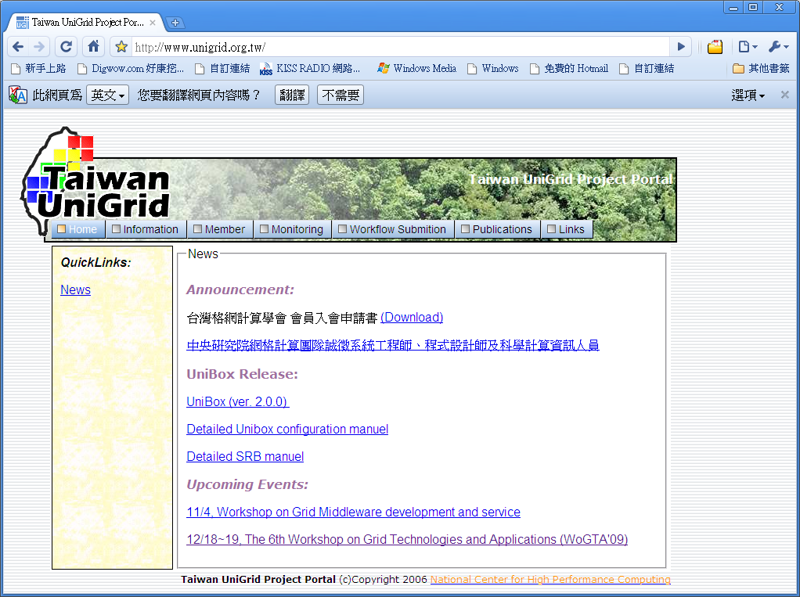
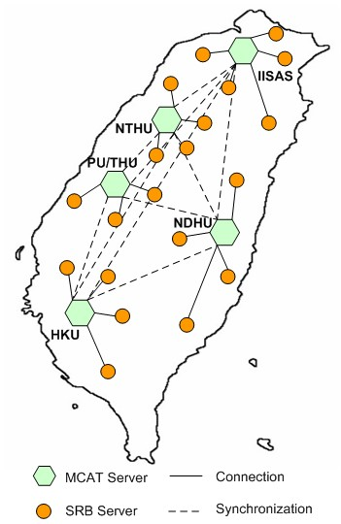
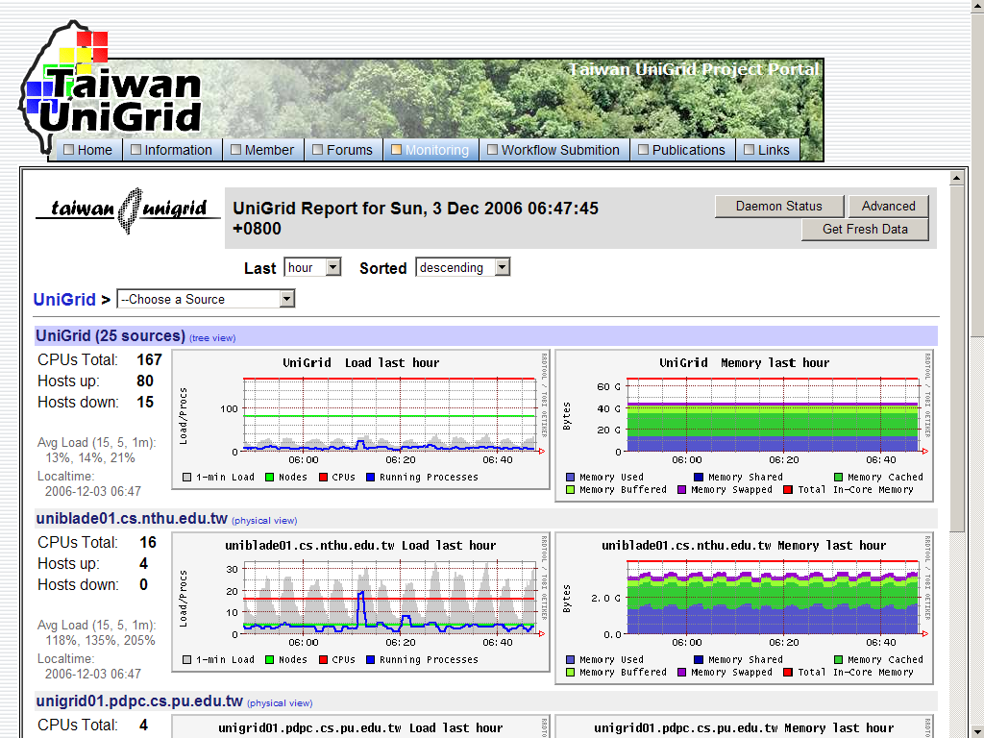
Screenshot

Slide 49
Computing Paradigm Evolution
What’s next ?
2100
2100
2100
2100
RESOURCE CAPACITY
2100
2100
2100
2100
2100
Desktop
(Single or Multi-processors)
SMPs or Super-computers
Local
Cluster
Enterprise
Cluster/Grid
Global
Cluster/Grid
Next big thing
Grid or Cloud??

Slide 50
Distributed computing
Cluster Computing
Grid Computing
Cloud Computing – Next big thing

Slide 51
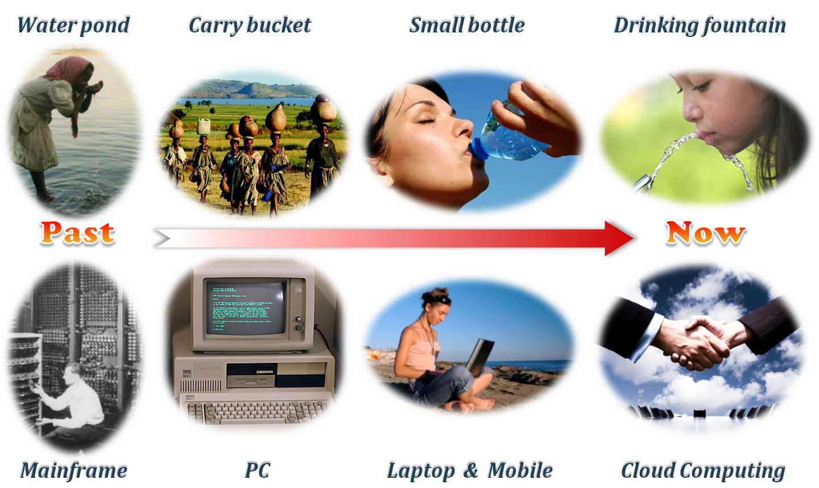
Long united, must divide
Long divided, must unite

Slide 52
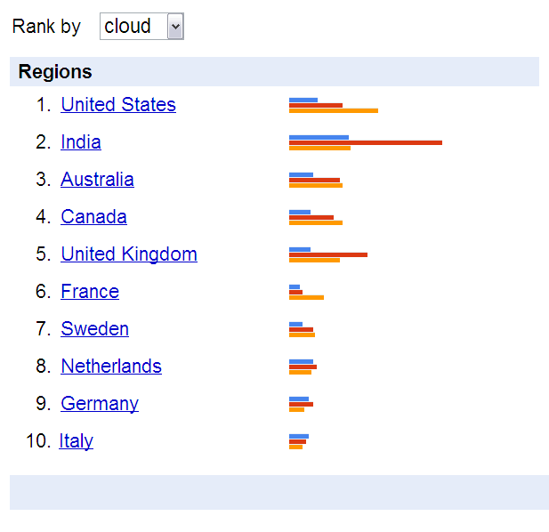
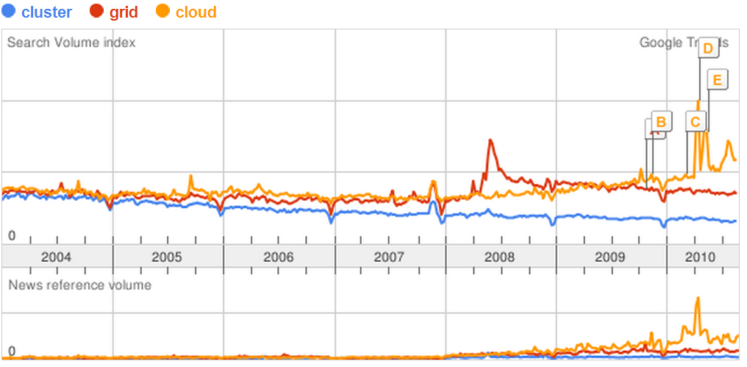
Next Big Thing
Google search trends – all years

Slide 53

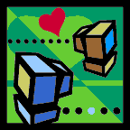




The “Cloud”
The term “cloud” is often used as a metaphor for the Internet.
  A simplified way to represent the complicated operations in the network
Currently, the term “cloud” is further used as an abstraction of complexities
  E.g., servers, applications, data, and heterogeneous platforms

Slide 54
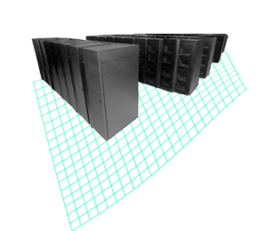
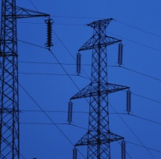

Cloud Computing – A New Paradigm
An IT service delivered to users that provides:
  A simple user interface that automatically provisions IT resources
  Capacity on demand with massive scalability
  Innovative service delivery models for applications
2009
Cloud Computing
1990
Software as a Service
Anytime, anywhere access to resources delivered dynamically as a service
Utility Computing
Network-based subscriptions to applications
Grid Computing
Offering computing resources as a metered service
Solving large problems with parallel computing

Slide 55
Cloud Computing in Mathematics
1
  One single integrated environment
  A collection pool of resources and services
0
  Zero management
  Automatic management and resilience of resource or service up/down/fail
∞
  Endless possibility
  Scalability, Availability, Accessibility, Manageability, Performance

Slide 56
Cloud Computing in IT
An acquisition and delivery model of IT resources
  Help improve business performance and control the costs of delivering IT resources to the organization
From a user perspective
  Provides a means of acquiring computing services via the internet while making the technology beyond the user device almost invisible
From an organization perspective
  Delivers services for consumer and business needs in a simplified way, providing unbounded scale and differentiated quality of service to foster rapid innovation and decision making

Slide 57
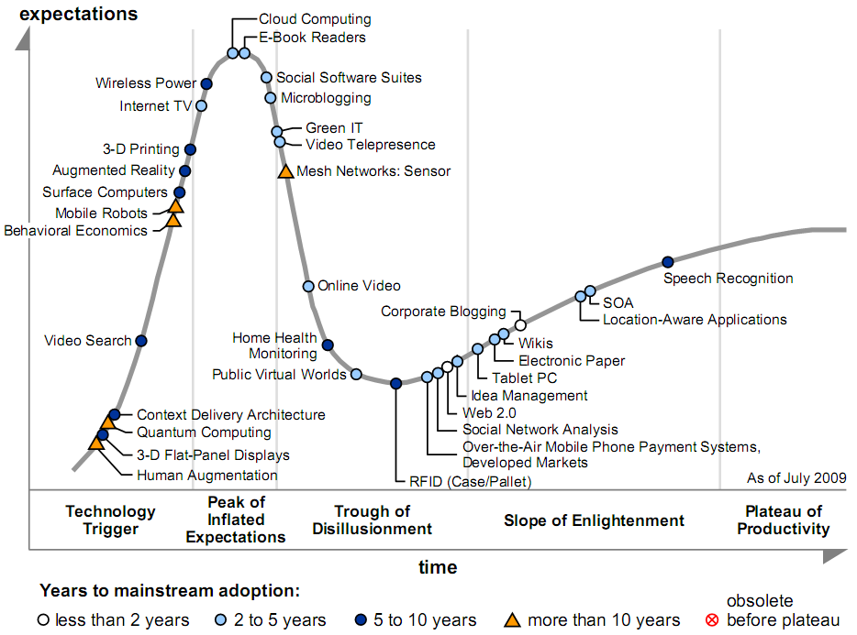
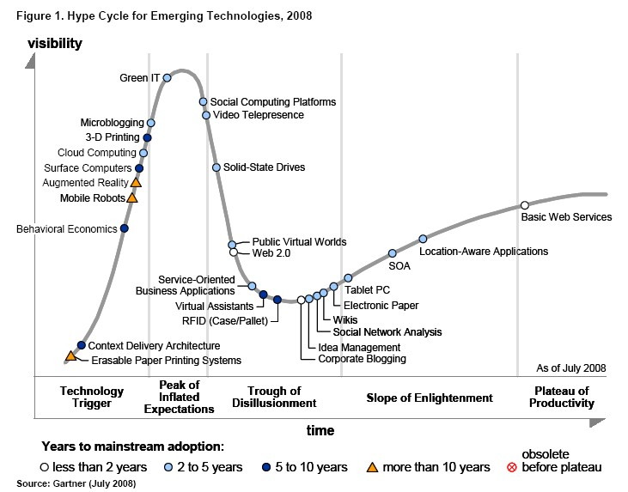
Emerging Technologies Hype Cycle
Gartner 2009

Slide 58
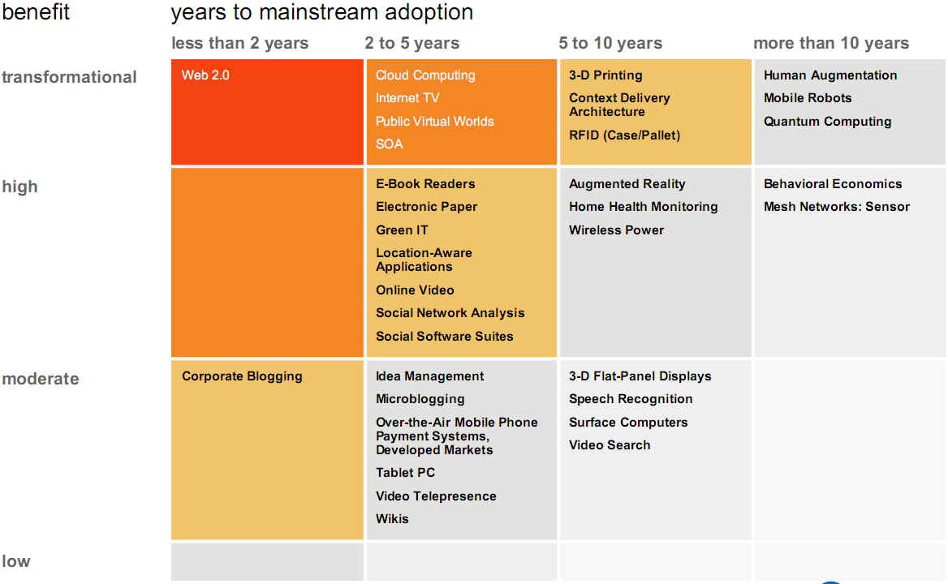
Emerging Technologies Priority Matrix
Gartner 2009

Slide 59
Benefits from Cloud Computing
Q: Rate the benefits commonly ascribed to the 'cloud'/on-demand model
Pay only for what you use
77.9%
Easy/fast to deploy to end-users
77.7%
Monthly payments
75.3%
Encourages standard systems
68.5%
Requires less in-house IT staff, costs
67.0%
Always offers latest functionality
64.6%
Sharing systems with partners simpler
63.9%
Seems like the way of the future
54.0%
0%
10%
20%
30%
40%
50%
60%
70%
80%
90%
Source: IDC Enterprise Panel, 3Q09, n = 263, September 2009

Slide 60
Adoption of Cloud Computing
Q: Rate your likelihood to pursue the cloud model for the following
Collaboration applications
67.3%
Web applications/Web serving
66.9%
Data Back-up or Archive services
59.4%
Business apps (CRM, HR, ERP)
55.6%
Personal productivity apps
55.1%
Data/Content Distribution services
54.8%
Storage capacity on demand
52.9%
IT Management software
51.3%
Server capacity on demand
50.6%
Business Intelligence/Analytics
49.8%
Application dev/test/deploy platform
49.1%
IT/Information Security
48.6%
0%
10%
20%
30%
40%
50%
60%
70%
80%
Source: IDC Enterprise Panel, 3Q09, n = 263, September 2009

Slide 61
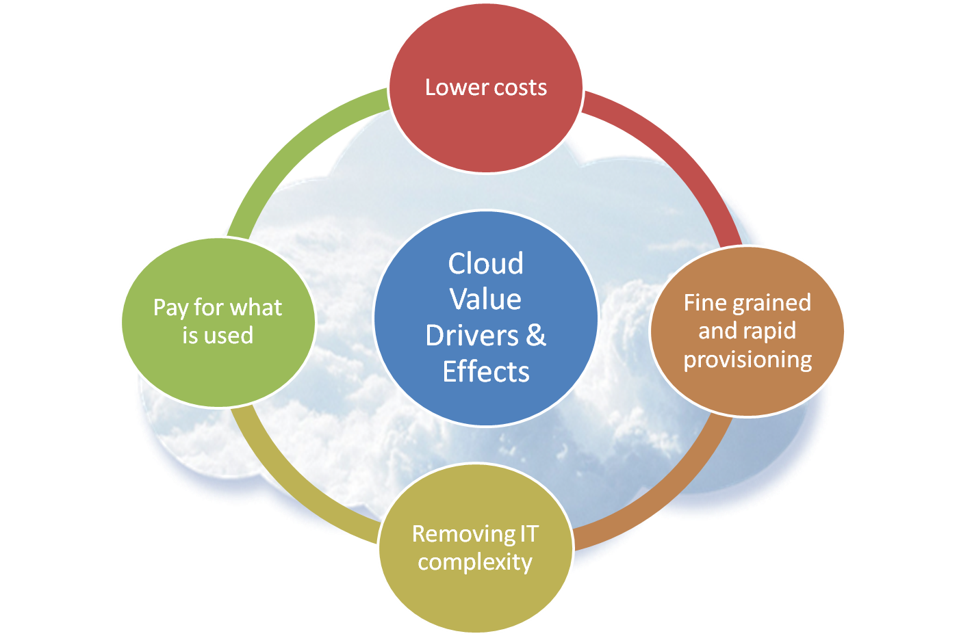
Cloud Value Drivers & Effects

Slide 62
Lower IT operating and capital costs
Lower costs
The leading value driver is lower IT operating and capital costs
Lower IT cost
  Optimize, consolidate and reduce servers
  Improve capital utilization & quality
  Reduce energy costs
Enables implementation of ideas or applications
  Cheaper pilots encourages experimentation and innovation
  Reduction in the costs for large, compute and storage intensive applications
  A Pay for Use model and the lower cloud costs of large computing and storage resources
Notes:
降低資訊營運成本與資本投入

Slide 63
Fine grained and rapid provisioning
Fine grained and rapid provisioning
Fine grained IT services with very rapid provisioning change the way IT can acquire capacity
 | Traditional IT | Cloud
Servers | Today buy large capacities using multi-year leases/ capital | With cloud capacity on demand, pay-as-you-go
Software | Today multi-year Software Licenses by seat | With cloud SaaS model, pay by the month
Infrastructure capacity in very small increments | Traditional IT capacities come in large increments with up-front capital costs | Fine grained cloud services allow capacity to be obtained on just what is needed then and on a pay-as-you-go basis
Rapid provisioning and scaling up or down easily | Today routine provisioning 2 to 3 weeks | With cloud provisioning in minutes to hours

Slide 64
Removing IT complexity
Removing IT complexity
Removing IT complexity from end users
End users can easy to access services without worrying about technical details
  Acquire computing services via the Internet
    using web-based user interface
  Cloud enhances user experience through faster and richer cloud services

Slide 65
Pay for what is used
Pay for what is used
Cloud pricing models based on paying for what is used
Avoid the upfront cost for infrastructure and the financial risk
  Cloud pricing models allow pay for what is used
  Scare capital needed to invest in infrastructure is replaced with an operating expense
Typical IT budget models :
  Applications: 35%
  Infrastructure: 60%
  Other: 5%

Slide 66
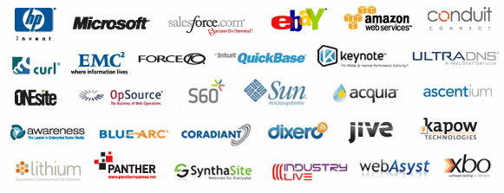

























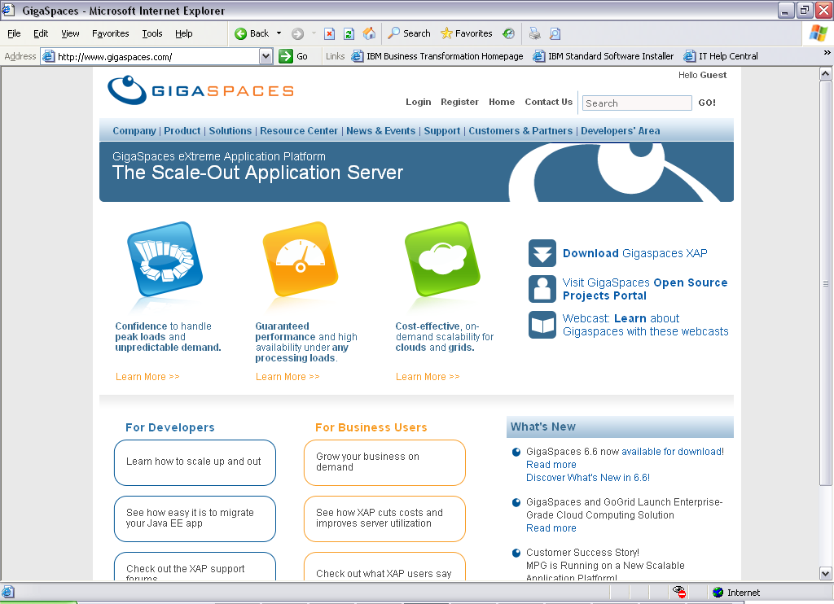








Cloud Computing Players more and more…

Slide 67
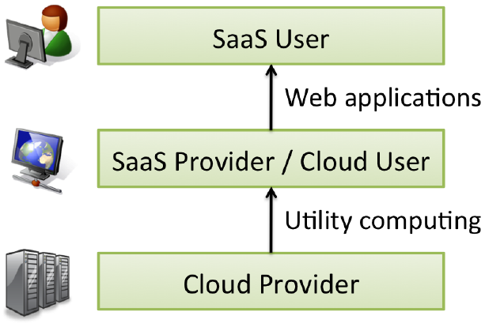
Players :
Users (Consumers) or Providers
Players can act as Users or Providers in the Cloud Ecosystem

Slide 68
Cloud Computing Economy
Enable SaaS providers that do not own IT infrastructure
Semiconductor
Industry
Software
Industry
Analogy
Foundries
(TSMC, UMC)
Cloud
Computing
Enable
Enable
Fabless
Chip Design
(e.g. nVidia…)
Datacenter-less
SaaS provider

Slide 69
Industry Chain
Mobile Phones
Cloud Services
Upstream – IC design
  Media Tech, Morning Star, etc.
Midstream – foundry
  TSMC, UMC, etc.
Downstream – production
  Asus, HTC, etc.
End Users
  Smart phone
Upstream – IaaS provider
  Amazon EC2, CHT hicloud, ect.
Midstream – PaaS provider
  Google GAE, Windows Azure, etc.
Downstream – SaaS provider
  Saleforce.com, Google docs, etc.
End Users
  Thin client

Slide 70
Summary
Long united, must divide; long divided, must unite
Modern IT require
  To increase capacity or add capabilities to their infrastructure dynamically
    without investing money in the purchase of new infrastructure
  All the while
    without needing to conduct training for new personnel
    without the need for licensing new software
Given a solution to the above mentioned demands
  Cloud computing is the next big thing in the world of IT

Slide 71
References
IEEE Standard Computer Dictionary: A Compilation of IEEE Standard Computer Glossaries, 1990.
R. Buyya (ed.), High Performance Cluster Computing: Systems and Architectures, Prentice Hall, 1999.
I. Foster, C. Kesselman (Eds.), The Grid: Blueprint for a Future Computing Infrastructure, Morgan Kaufmann, San Francisco, USA, 1999
I. Foster et. al., “The Anatomy of the Grid. Enabling Scalable Virtual Organizations,” International Journal of High Performance Computing Applications, 2001.
Computing Curricula 2005
J. Rittinghouse and J. F. Ransome, Cloud Computing: Implementation, Management, and Security, CRC Press, 2009.
M. Armbrust et. al., “Above the Clouds: A Berkeley View of Cloud Computing,” Technical Report No. UCB/EECS-2009-28, University of California at Berkeley, 2009.
R. Buyya et. al., “Cloud computing and emerging IT platforms: Vision, hype, and reality for delivering computing as the 5th utility,” Future Generation Computer Systems, 2009.
Hai Jin and Raj Buyya, High Performance Cluster Computing: Architectures and Systems.
NIST (National Institute of Standards and Technology). http://csrc.nist.gov/groups/SNS/cloud-computing/
Gartner, Inside the Hype Cycle: What’s Hot and What’s Not in 2009.
Cloud Computing 2010 – An IDC Update.
IBM Corporation.
From Wikipedia, the free encyclopedia.
All resources of the materials and pictures were partially retrieved from the Internet.

